Slide 1
BASIS DATA LANJUT
PL/SQL Control Structures
Oleh : (3122600003)Dukhaan Kamimpangan
Kelas : 2 D4 IT A

Slide 2
TUGAS
5
PL/SQL Composite Data Type dan Cursor

Slide 3
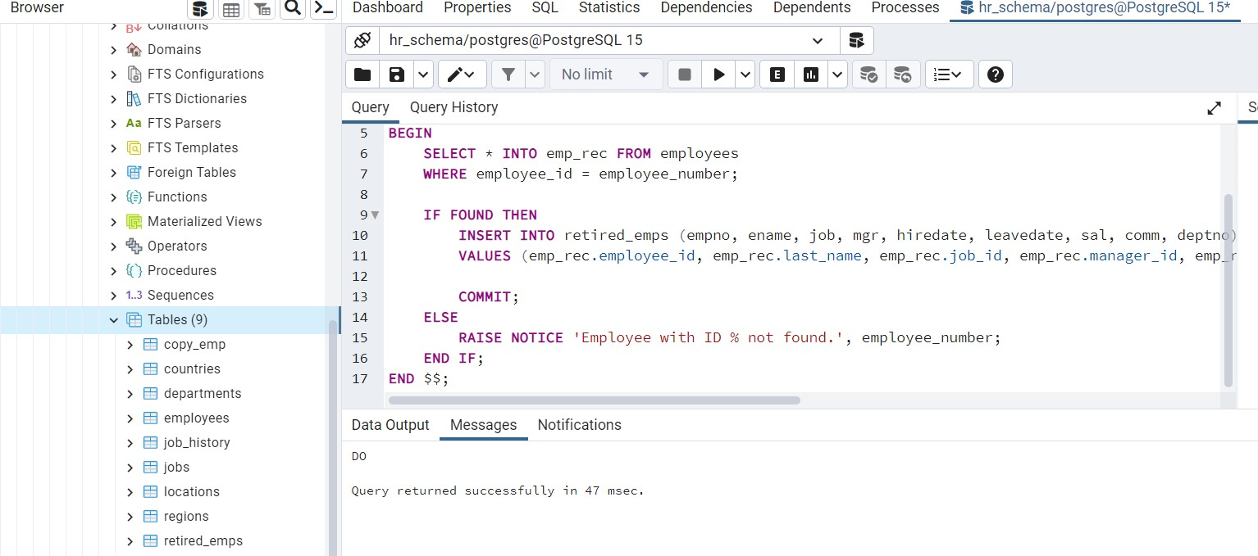
PART 1
Cursor And Record
DO $$
DECLARE
v_empno employees.employee_id%TYPE;
v_ename employees.last_name%TYPE;
emp_cursor CURSOR FOR SELECT employee_id, last_name FROM employees;
BEGIN
OPEN emp_cursor;
FOR i IN 1..10 LOOP
FETCH emp_cursor INTO v_empno, v_ename;
EXIT WHEN NOT FOUND;
RAISE NOTICE 'Employee ID: %, Last Name: %', v_empno, v_ename;
END LOOP;
CLOSE emp_cursor;
END $$;

Slide 4
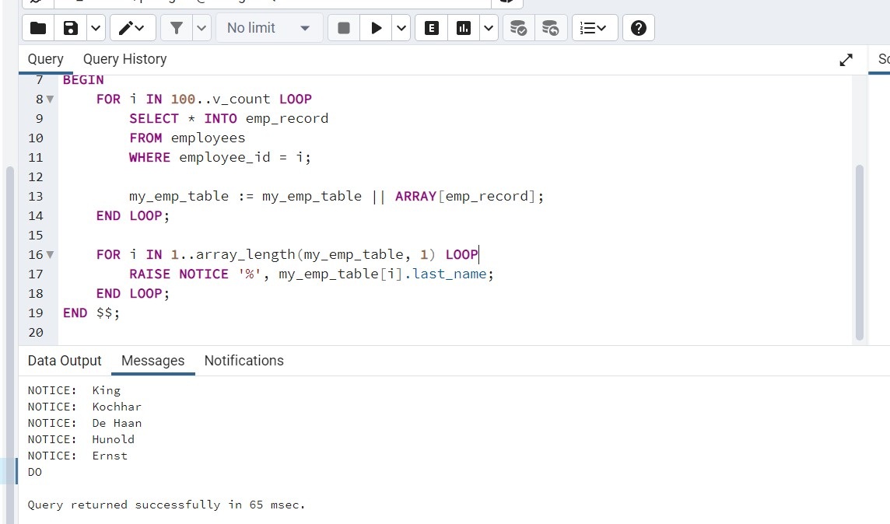
Cursor For Loop
DO $$
DECLARE
my_emp_table employees[];
v_count integer := 104;
emp_row employees;
BEGIN
FOR i IN 100..v_count LOOP
SELECT * INTO emp_row FROM employees WHERE employee_id = i;
IF FOUND THEN
my_emp_table := my_emp_table || ARRAY[emp_row];
END IF;
END LOOP;
FOR i IN 1..array_length(my_emp_table, 1) LOOP
RAISE NOTICE '%', my_emp_table[i].last_name;
END LOOP;
END $$;

Slide 5
TUGAS
6
PL/SQL Explicit Cursor

Slide 6
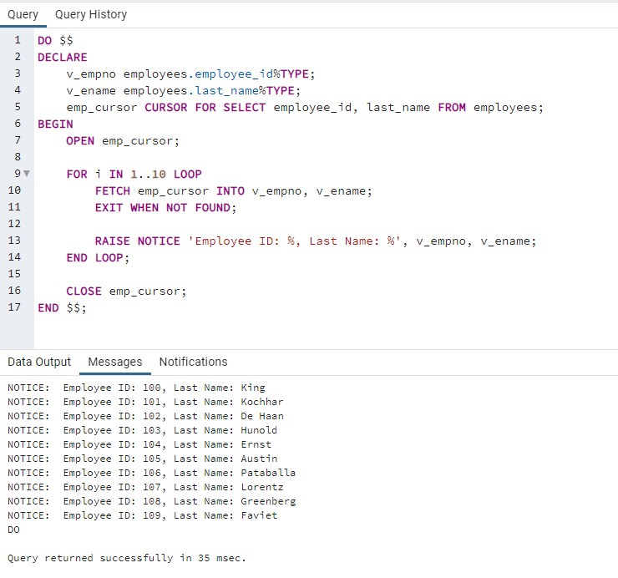
Row Count & Not Found
DO $$
DECLARE
v_empno employees.employee_id%TYPE;
v_ename employees.last_name%TYPE;
emp_cursor CURSOR FOR SELECT employee_id, last_name FROM employees;
BEGIN
OPEN emp_cursor;
FOR i IN 1..10 LOOP
FETCH emp_cursor INTO v_empno, v_ename;
EXIT WHEN NOT FOUND;
RAISE NOTICE 'Employee ID: %, Last Name: %', v_empno, v_ename;
END LOOP;
CLOSE emp_cursor;
END $$;

Slide 7
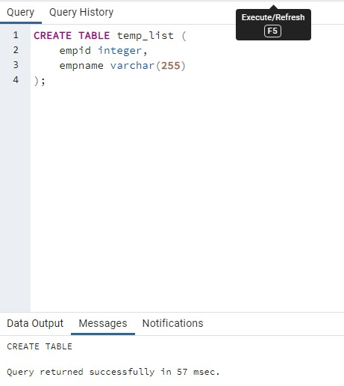
Cursor Record
CREATE TABLE temp_list (
empid integer,
empname varchar(255)
);

Slide 8
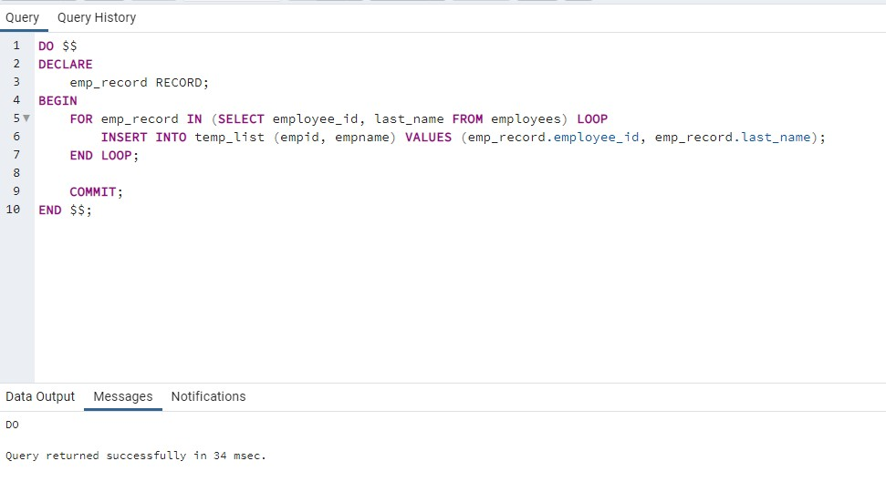
Cursor Record
DO $$
DECLARE
emp_record RECORD;
BEGIN
FOR emp_record IN (SELECT employee_id, last_name FROM employees) LOOP
INSERT INTO temp_list (empid, empname) VALUES (emp_record.employee_id, emp_record.last_name);
END LOOP;
COMMIT;
END $$;

Slide 9
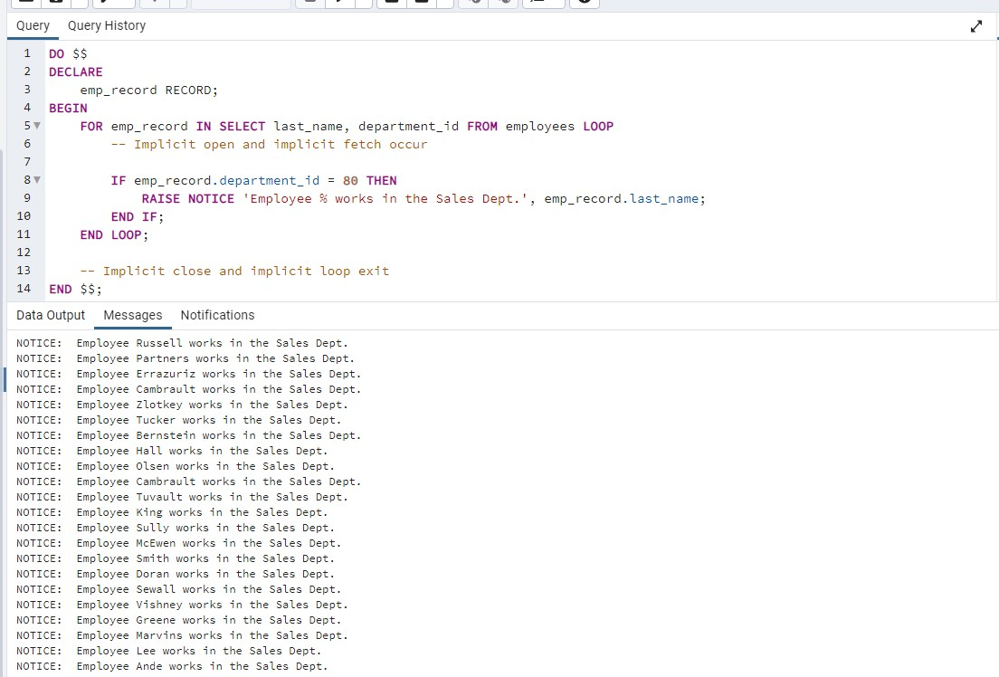
Cursor Record
DO $$
DECLARE
emp_record RECORD;
BEGIN
FOR emp_record IN SELECT last_name, department_id FROM employees LOOP
-- Implicit open and implicit fetch occur
IF emp_record.department_id = 80 THEN
RAISE NOTICE 'Employee % works in the Sales Dept.', emp_record.last_name;
END IF;
END LOOP;
-- Implicit close and implicit loop exit
END $$;

Slide 10
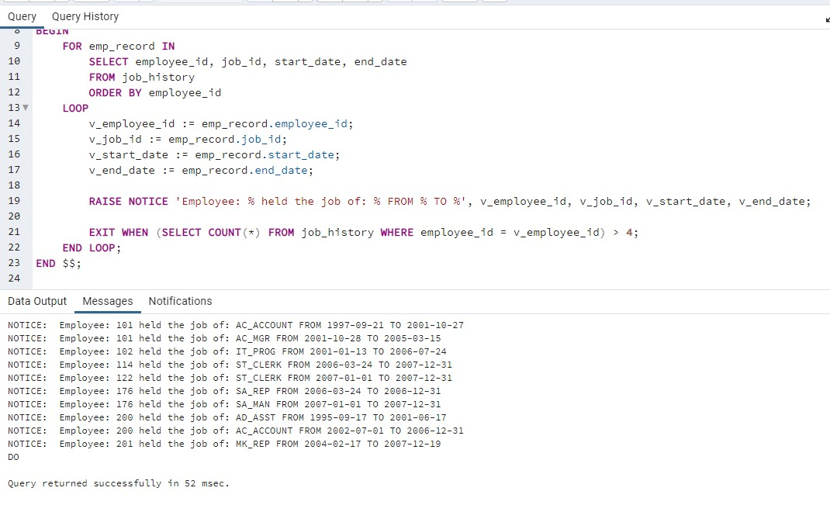
Cursor Record
DO $$
DECLARE
v_employee_id employees.employee_id%TYPE;
v_job_id employees.job_id%TYPE;
v_start_date DATE;
v_end_date DATE;
emp_record RECORD;
BEGIN
FOR emp_record IN
SELECT employee_id, job_id, start_date, end_date
FROM job_history
ORDER BY employee_id
LOOP
v_employee_id := emp_record.employee_id;
v_job_id := emp_record.job_id;
v_start_date := emp_record.start_date;
v_end_date := emp_record.end_date;
RAISE NOTICE 'Employee: % held the job of: % FROM % TO %', v_employee_id, v_job_id, v_start_date, v_end_date;
EXIT WHEN (SELECT COUNT(*) FROM job_history WHERE employee_id = v_employee_id) > 4;
END LOOP;
END $$;

Slide 11
TERIMA KASIH

